Slide 1
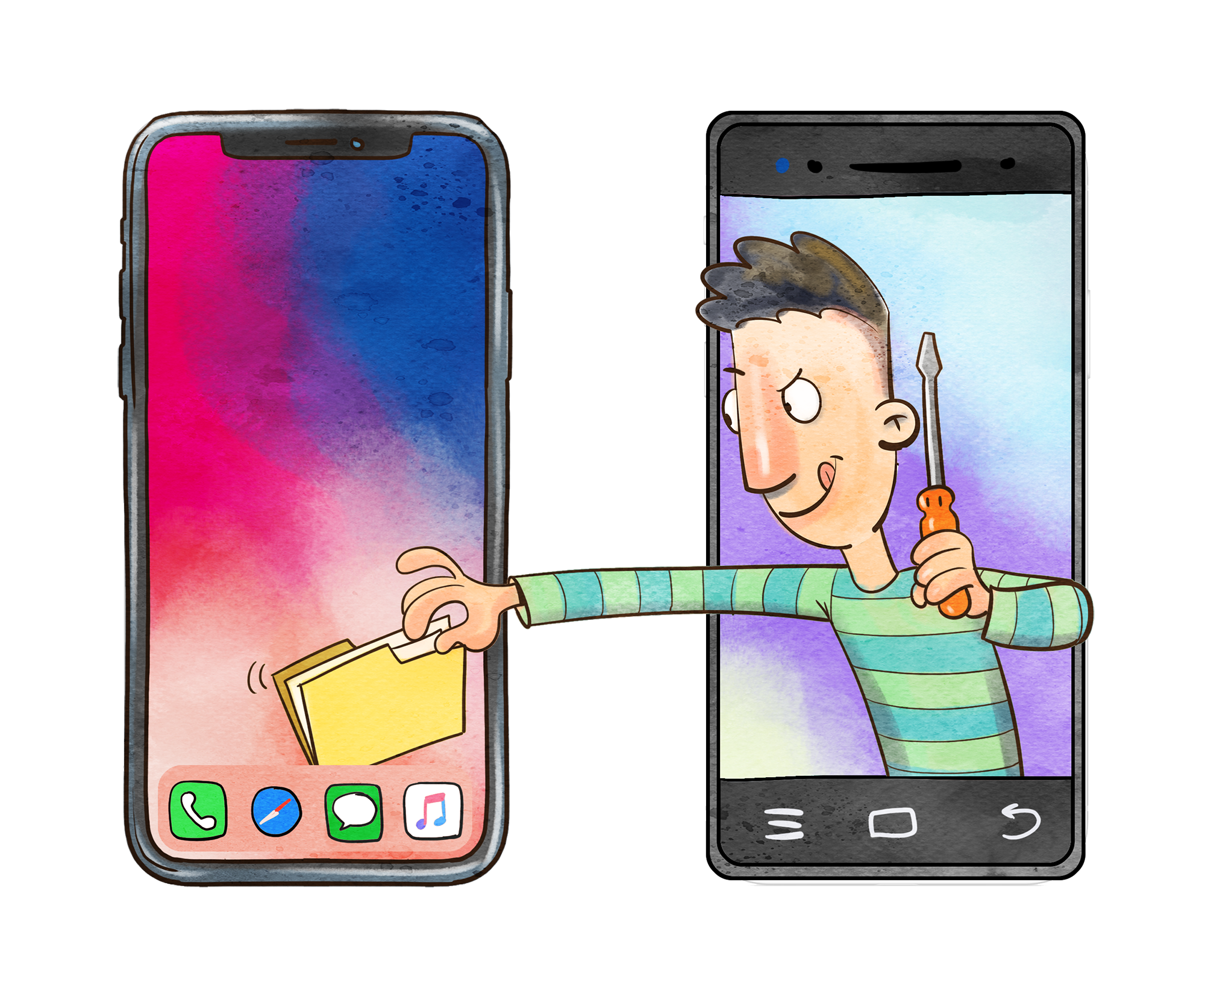
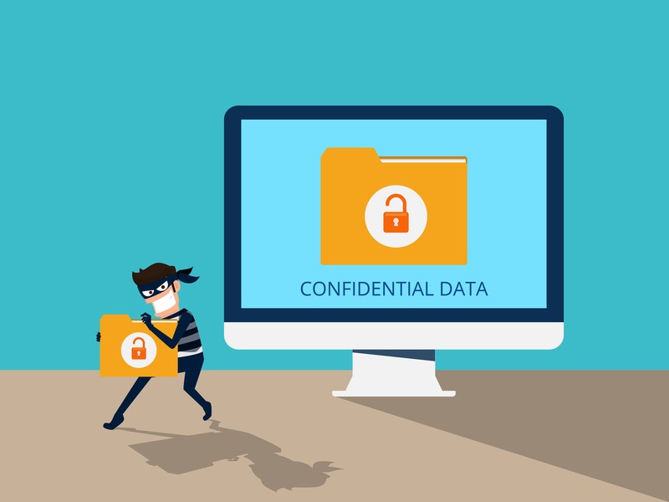




PROTECT YOUR DATA
Avoid apps that leak your information
Use strong passwords to protect your confidential files
Protect your device from thefts and data loss.
Beware of untrusted apps and malicious softwares
Erase all apps before you recycle
Use antivirus-software to protect your devices

Slide 2


Slide 3
Protect your data:
1. Secure your hardware
2. Encrypt and backup data
3. Create a secure workplace
4. Use anti-malware and firewall software

